Slide 1
DATA VISUALIZATION & DASHBOARDING PROJECT Superstore sales analysis dashboard
Prepared: Veronica James okuba
Analystlab Africa internship
WEEK: 4

Slide 2
About the dataset
The project uses the sample superstore Dataset, which contains retail transaction records from a superstore business.
The dataset include:
Customer information
Product categories and sub-categories
Sales transactions
Regional performance
Profit and discount records
Order dates
Purpose
The dataset helps analyze business performance and identify areas for improvement.

Slide 3
Business problem
Business generate large volumes of sales data daily, but raw data alone does not support decision-making.
This project aims to answer important business questions such as:
Which region generates the highest sales?
Which region is most profitable?
Which product sub-category sells best?
How does discount affect profit?
What sales trend exist over time?
The goal is to transform raw data into actionable business insights using interactive dashboard.

Slide 4
KEY PERFORMANCE INDICATORS (KPIs)
The following KPIs were used to measure business performance:
KPI SUMMARY
Total Sales: $2.3 Million
Total Profit: $286 Thousand
Total Quantity Sold: 38 Thousand Units
Additional metric analyzed:
Regional sales performance
Profit by category
Monthly Sales trend
Discount impact on profitability

Slide 5
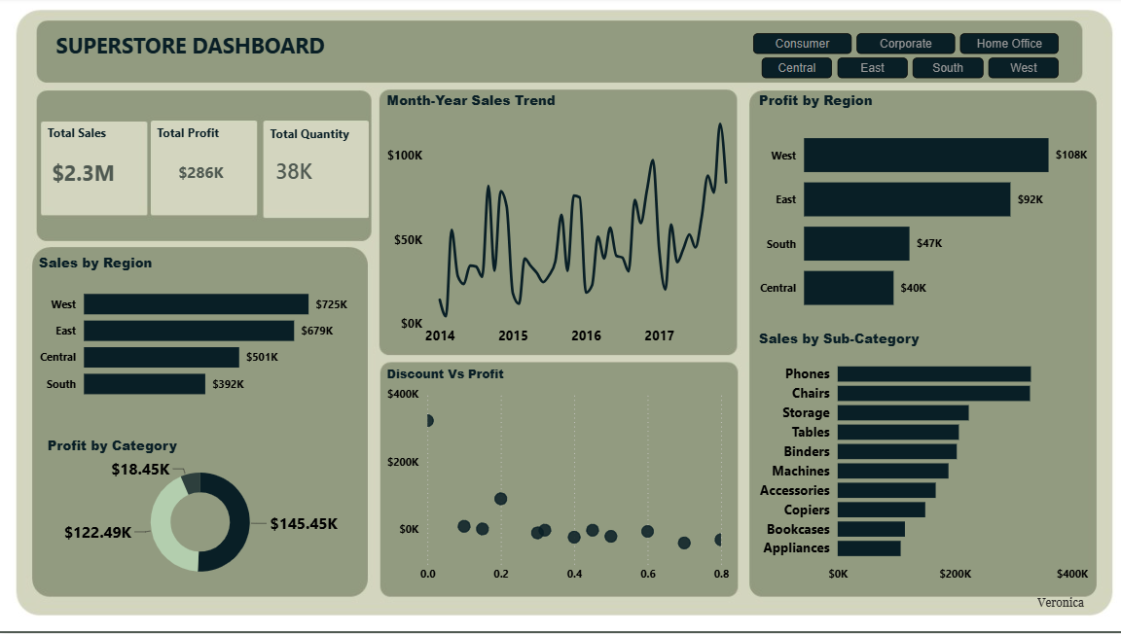
Dashboard

Slide 6
Key insights
West Region Leads In Sales
The west region generated the highest sales at approximately $725K.
West Region Has Highest Profit
The west region also produced the highest profit at $108K.
South Region Underperforms
The south region recorded the lowest sales and profit.
Phones Are Best-Selling product
Among all sub-categories, phone generated the highest sales.

Slide 7
More insights
Product by Category
The most profitable category contributes about $145K in profit.
Discount Impact
The scatter plot show that:
Lower discounts tend to maintain profitability.
Higher discounts often reduced product
Excessive discounts may cause losses
Sales Trend
Sales Increased over time with noticeable fluctuations, indicating seasonal demand patterns.

Slide 8
recommendations
Increase investment in high-performing regions such as West and East.
Investigate why the south region is underperforming.
Reduce excessive discounts to improve profit margins.
Increase stock and marketing for top-selling products such as phones and chairs.

Slide 9
CHALLENGES FACED
Challenges encountered during the project include:
Understanding Power BI dashboard design
Creating DAX measures for KPIs
Choosing the most suitable visualizations
Map Visualization restriction in Power BI settings
These Challenges improved my problem-solving and dashboarding skills.

Slide 10
THANK YOU

